Slide 1
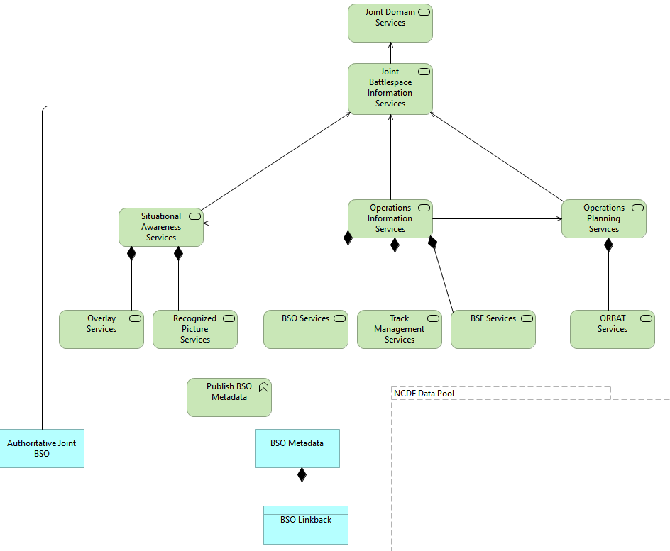
C3T Joint Battlespace Information Services

Slide 2
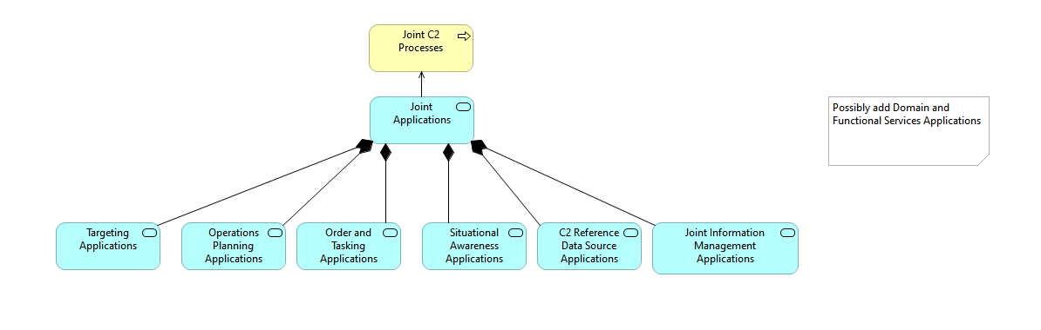
C3T Joint C2 Applications

Slide 3
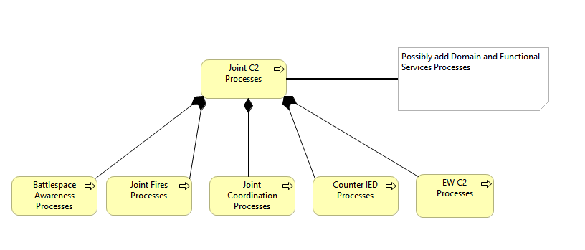
C3T Joint C2 Processes

Slide 4
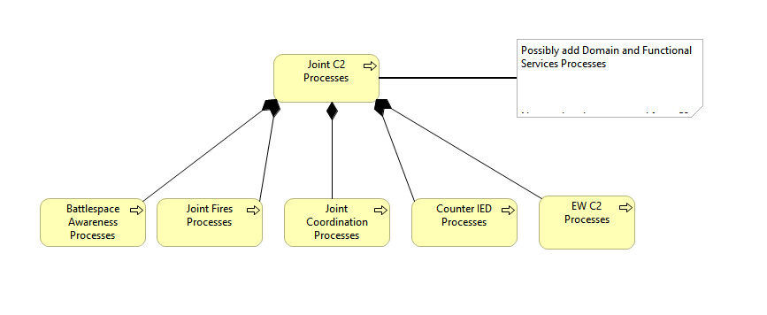
C3T Joint Domain Services

Slide 5
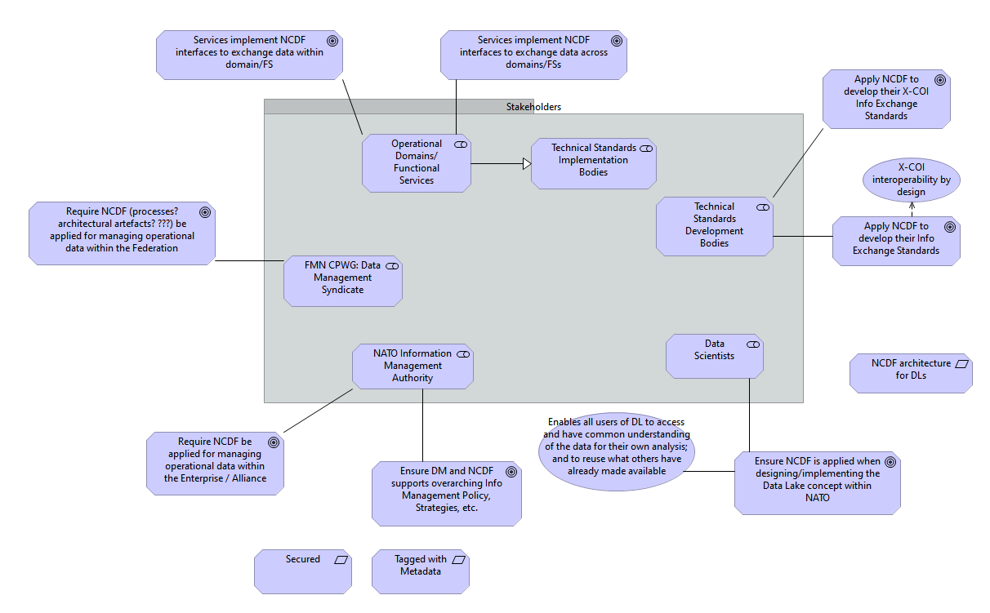
DM CaT Business Strategy C2

Slide 6
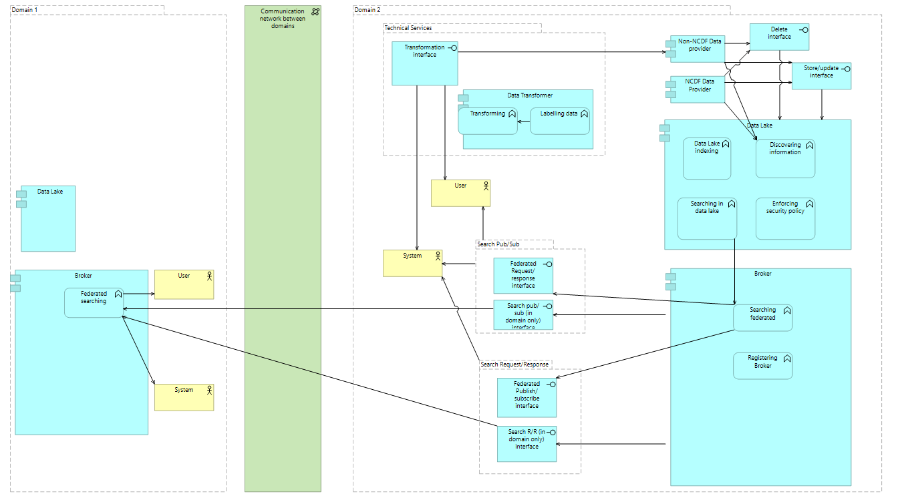
NCDF Application Cooperation

Slide 7
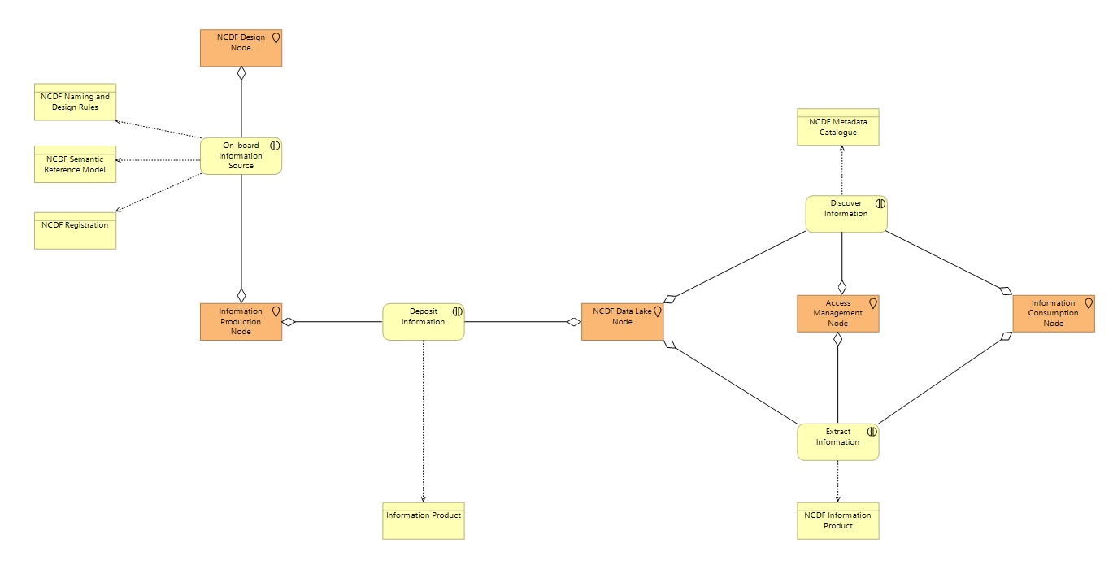
NCDF Data Lake L2

Slide 8
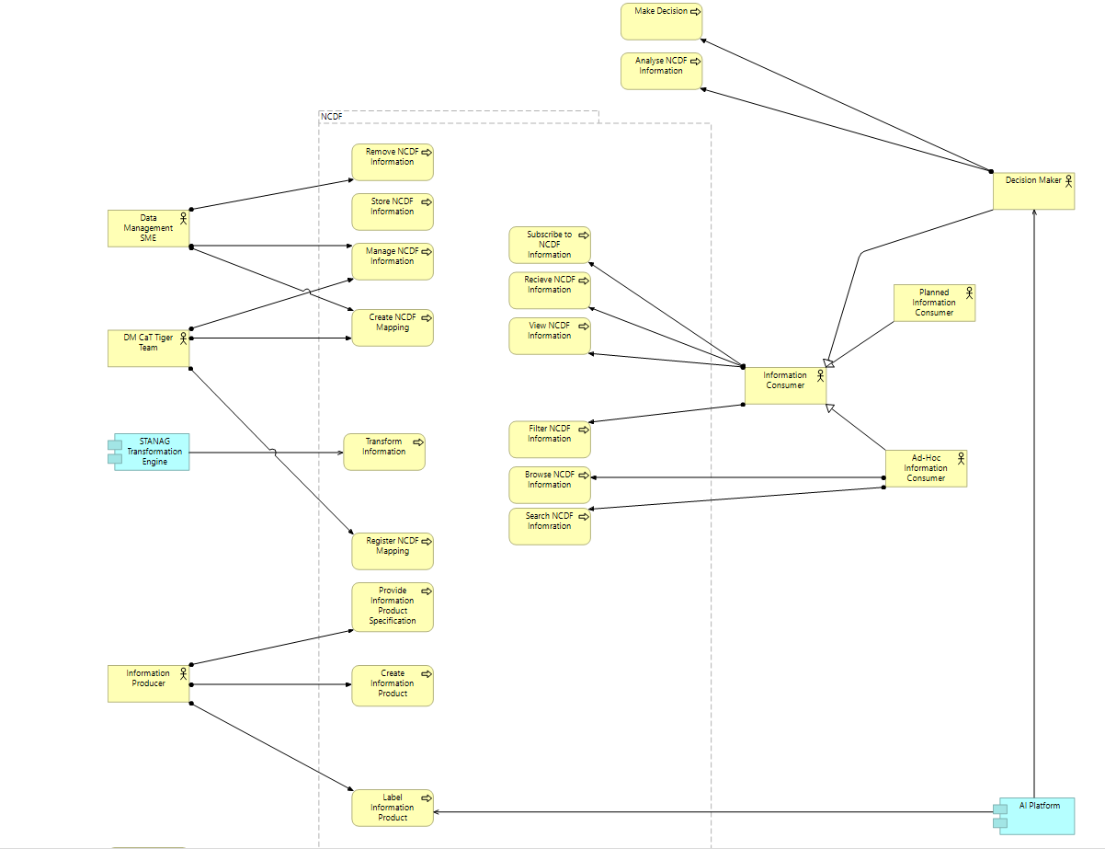
NCDF Data Lake L4.0 Use Cases

Slide 9
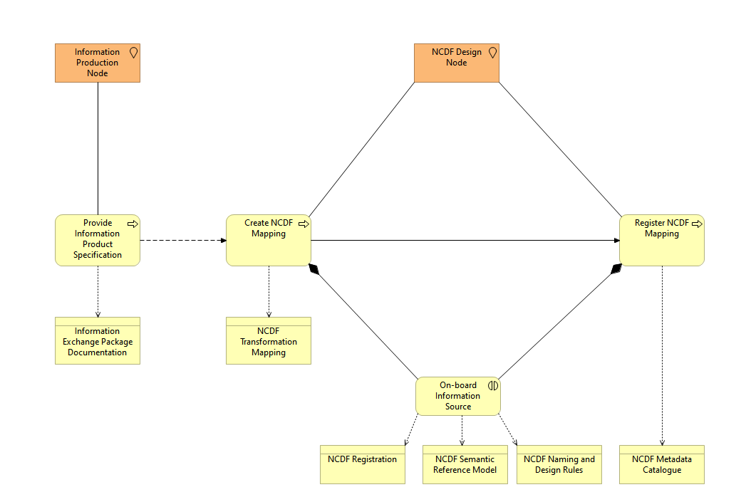
NCDF Data Lake L4.1 On-Board

Slide 10
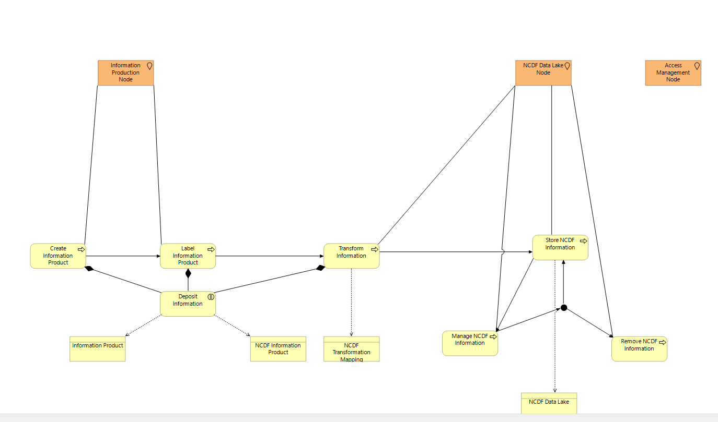
NCDF Data Lake L4.2 Store

Slide 11
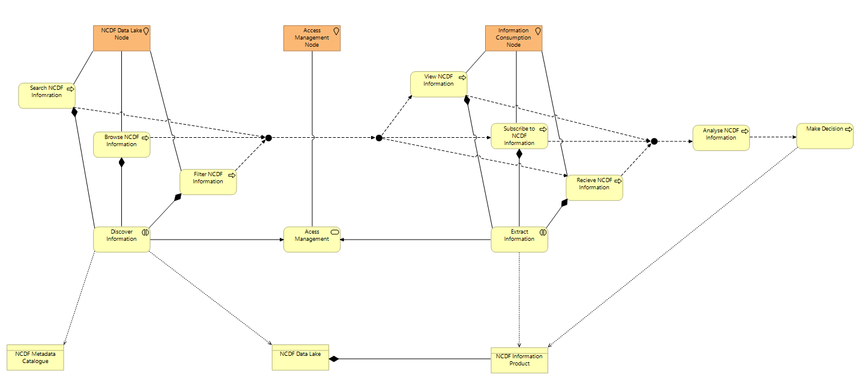
NCDF Data Lake L4.3 Exploit

Slide 12
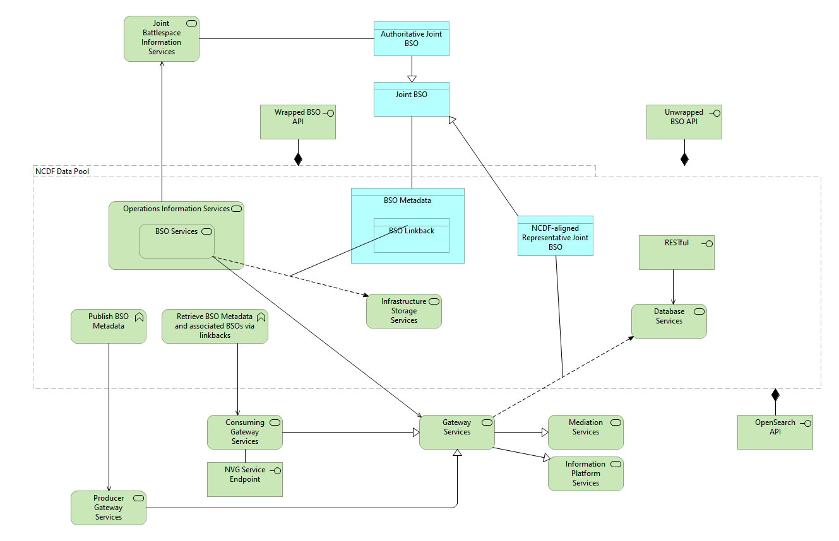
NCDF Data Lake P3 2019

Slide 13
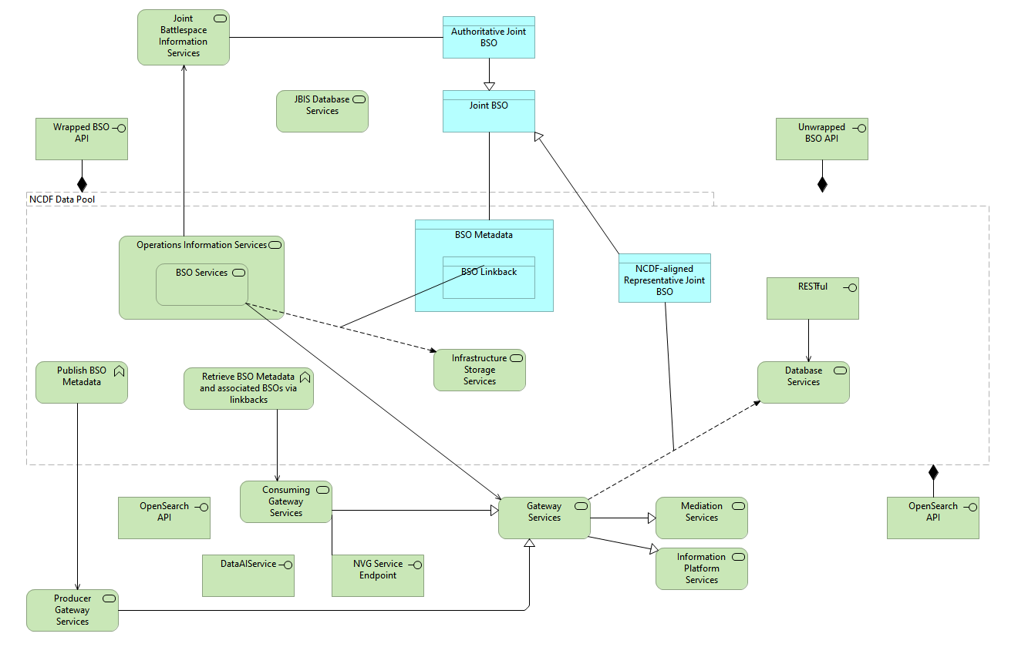
NCDF Data Lake P3 2020 (JISR)

Slide 14
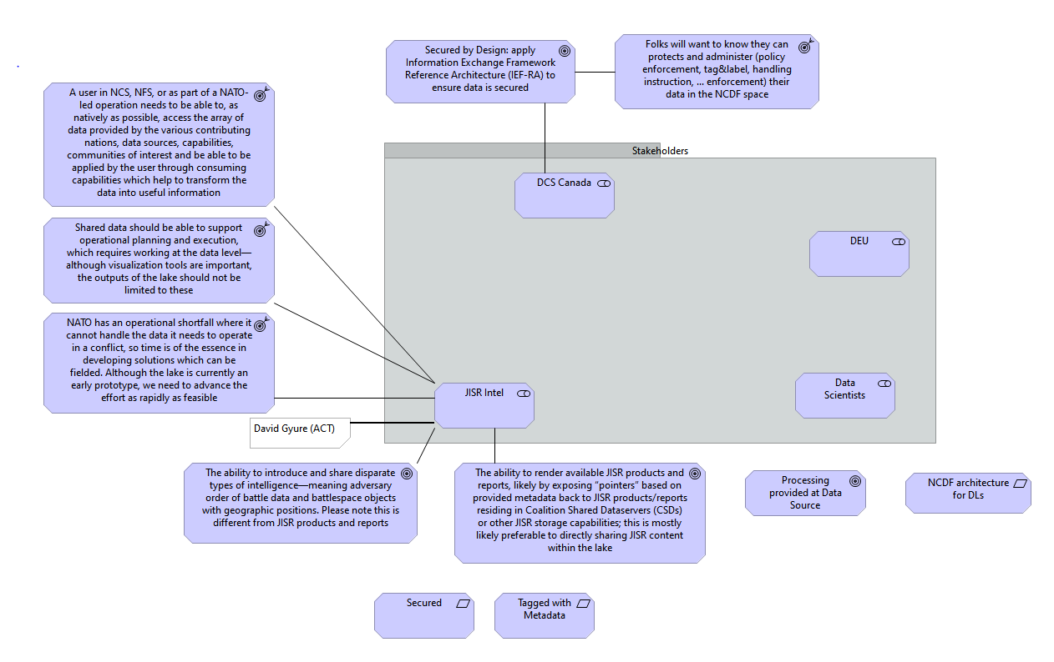
NCDF Data Lake Business Strategy 2020 Business Strategy Inputs C2

Slide 15
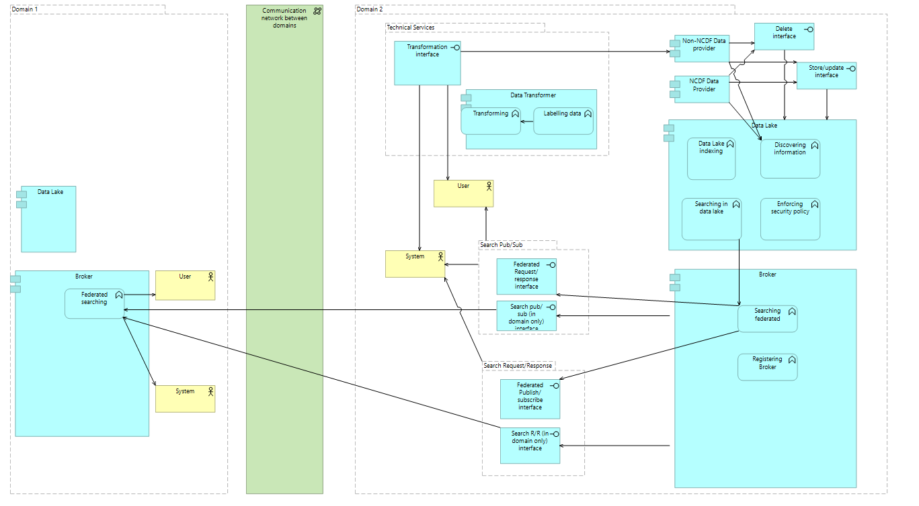
NATO Core Data Framework Architecture

Slide 16
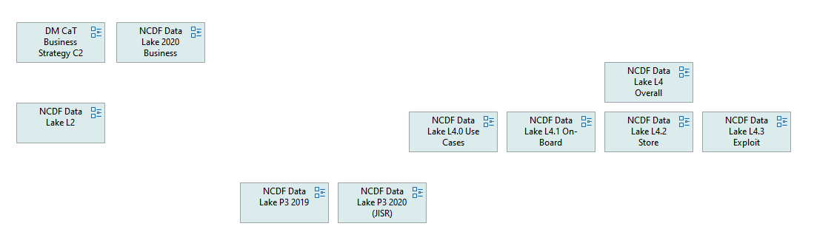
NCDF Views Overview

